Slide 1
EDAB 6808 · Assignment 4
Natural Language Processing of Bitcoin Tweets
Topic modelling, sentiment polarity and Bitcoin volatility
Lwazi Nhlapo (2021856345) · Buhle Mbokodo (2024007920)
B.Com Hons Business Analytics · University of the Free State

Slide 2
Project overview
24,187
201
6
60
English tweets analysed
dates, 6 Mar 2025 – 2 Mar 2026
NMF topics retained
tweets manually reviewed
Question 1 · Topic modelling
Question 2 · Sentiment and volatility
What are the dominant themes in Bitcoin tweets, and how do they shift over time?
Can tweet sentiment help explain or forecast next-day Bitcoin volatility?

Slide 3
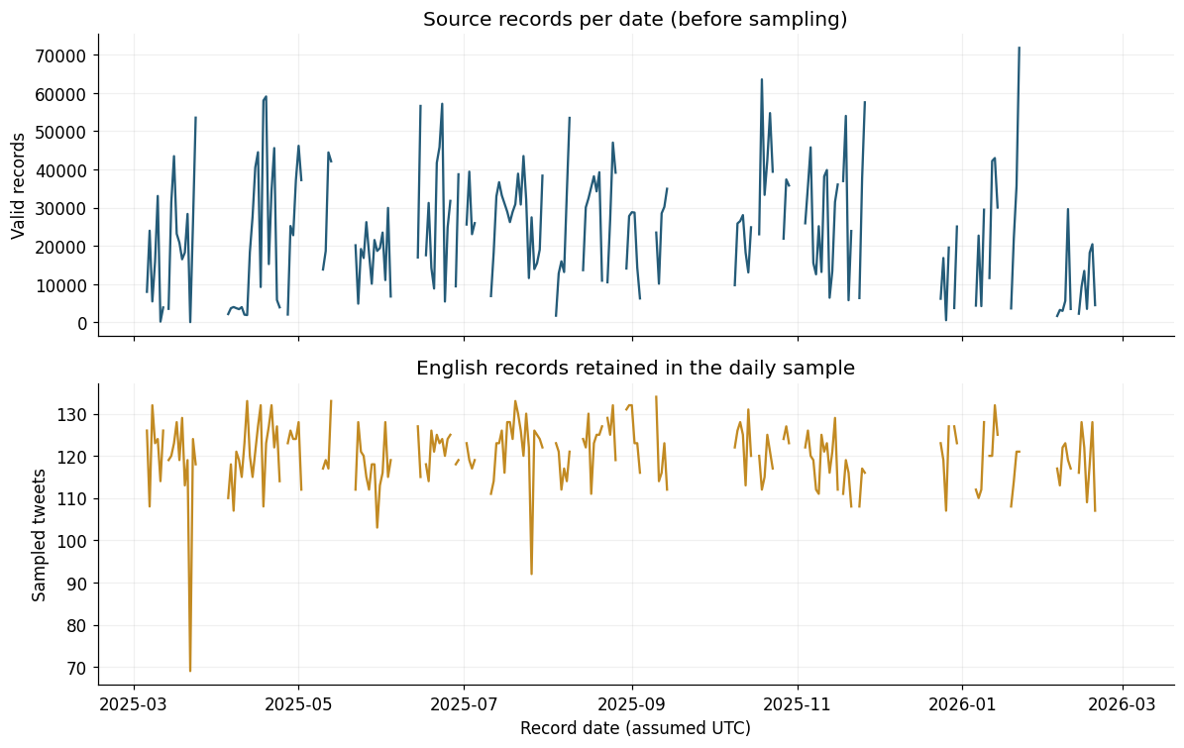
Data and text preparation
Sample: 30,083 tweets, up to 150 per date, reproducible
English filter: probability ≥ 0.90 keeps 24,187; 5,896 excluded
Kept: hashtags and domain terms
Removed: URLs, mentions, boilerplate (bitcoin, btc, rt), stopwords
Caveat: malformed records and unverified timestamps were repaired and flagged
Top: source records per date. Bottom: English tweets kept per day.

Slide 4
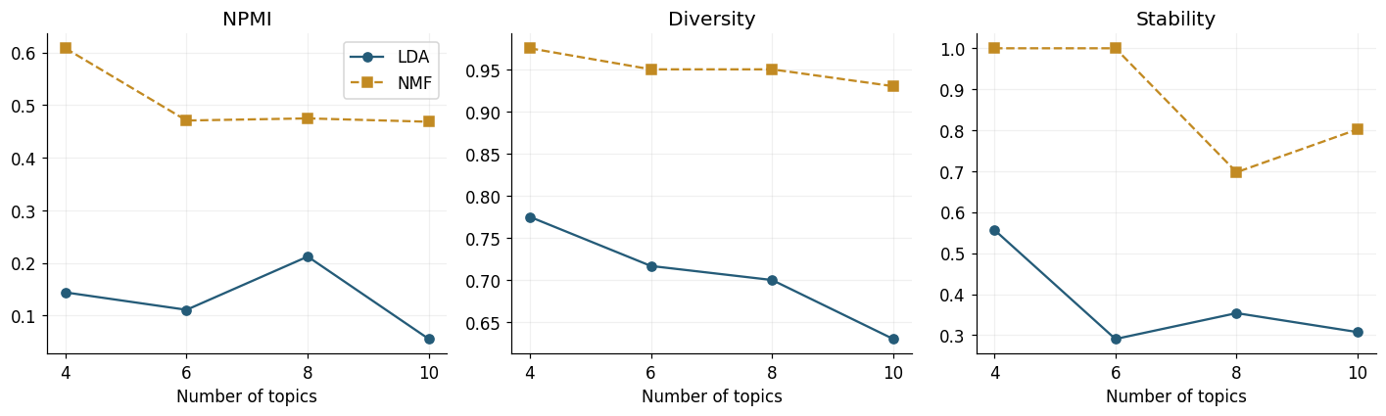
Choosing the topic method and number of topics
NMF beats LDA
NMF is stable
Why K = 6
NPMI 0.471 vs 0.111 at K = 6; top-term diversity 0.95 vs 0.72
Two-seed stability 1.00 at K = 4 and 6, against 0.29 for LDA at K = 6
K = 4 merged trading and NFT talk; K = 8 and 10 were less stable (0.70, 0.80)

Slide 5
Six topics: trading talk dominates
Trading: 47.5% of the conversation is prices, buy/sell and targets
Broad crypto: NFT, news and airdrop topics add another 48.6%
Niche but distinctive: Lightning faucet (2.4%) and Coin Hunt World (1.6%) are repeated templated posts

Slide 6
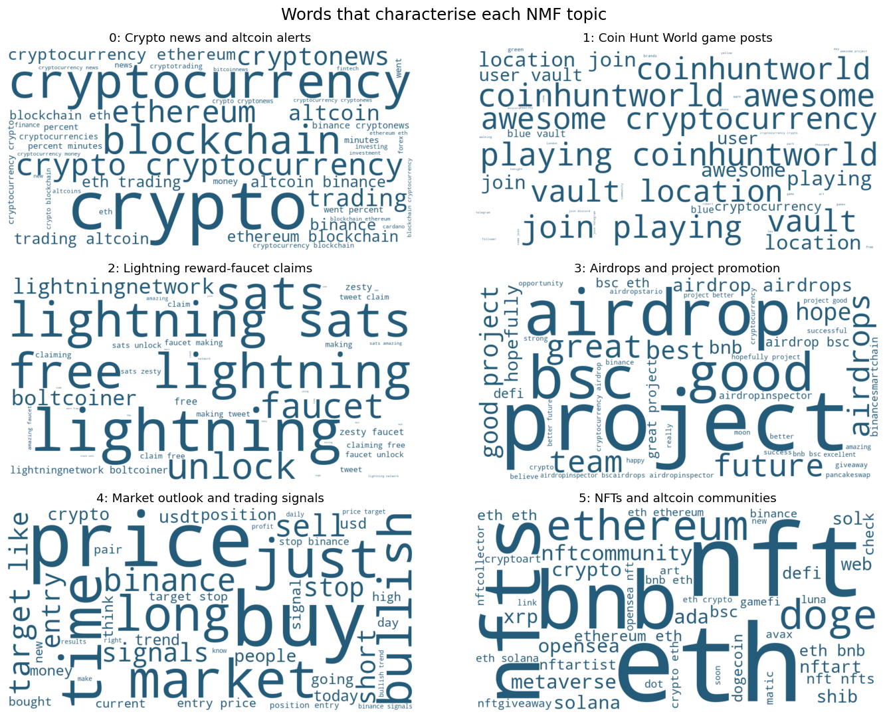
What each topic contains
Market: “Long position… Entry… Target… Stop”
NFT: OpenSea, #nft and #Ethereum promotion
News: templated price alerts across many assets
Airdrops: giveaways and “great project” hype
Lightning: “claim free Lightning sats”
Coin Hunt: vault and “join me playing” posts

Slide 7
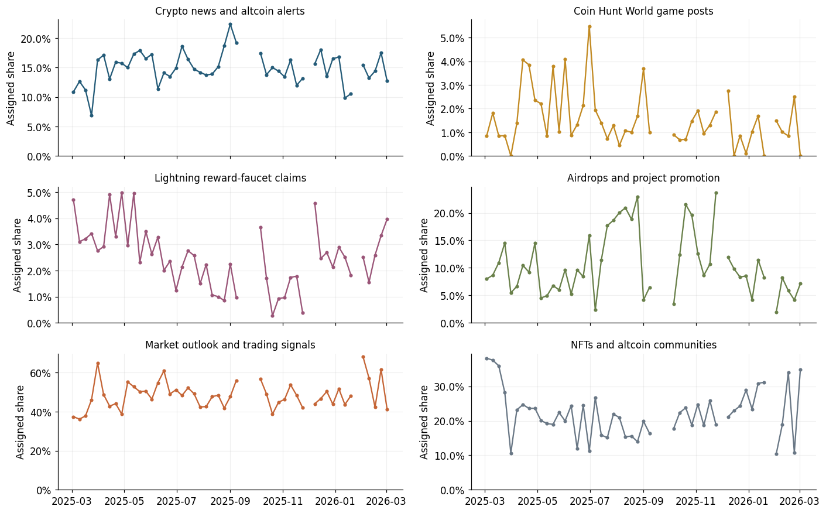
How the topics moved over time
Trading: 37.4% to 41.3% (+3.8 pp)
NFT/altcoin: 38.2% to 34.9% (−3.2 pp)
Others: news +1.8 pp; airdrops −0.8; Lightning −0.7; game −0.9
Peak: trading reached 68.2% in the week of 2 Feb 2026
Describes the sampled conversation, not why it changed.

Slide 8
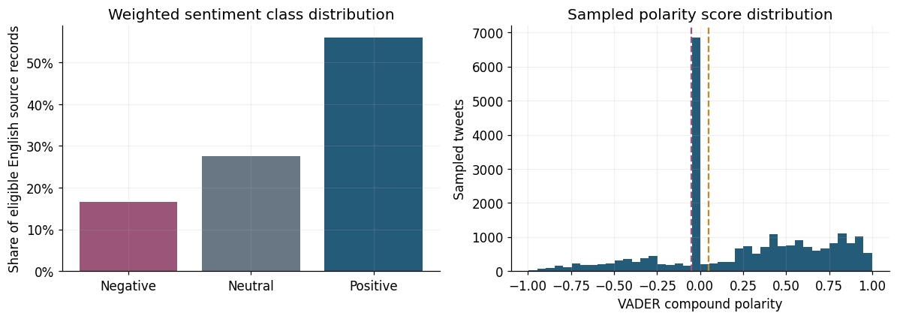
Sentiment scoring: VADER and RoBERTa
56.0% Positive
27.5% Neutral
16.5% Negative
Rule: VADER compound ≥ +0.05 is Positive, ≤ −0.05 is Negative, otherwise Neutral
Spike at zero: many factual or templated tweets score Neutral
Second method: frozen Twitter RoBERTa on the same tweets

Slide 9
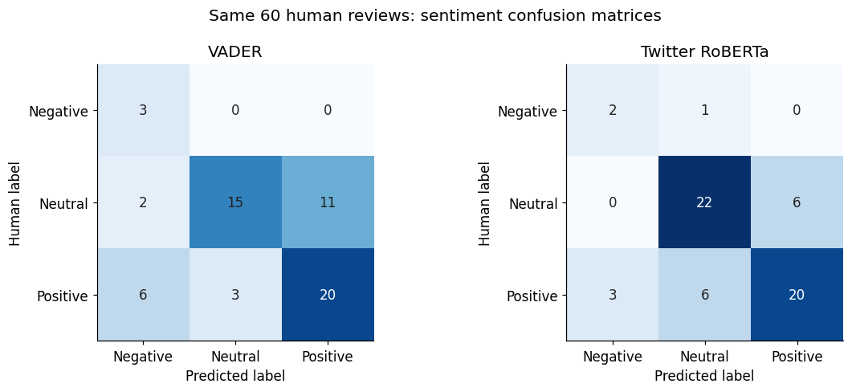
Validation on 60 human-labelled tweets
VADER
63.3% 38 of 60 correct
Twitter RoBERTa
73.3% 44 of 60 correct
Macro-F1: 0.582 to 0.666; neutral recall 53.6% to 78.6%
Errors: promotion, sarcasm, factual price alerts, praise of one coin and criticism of another
Caution: only 3 Negative tweets in the sample; paired test p = 0.238

Slide 10
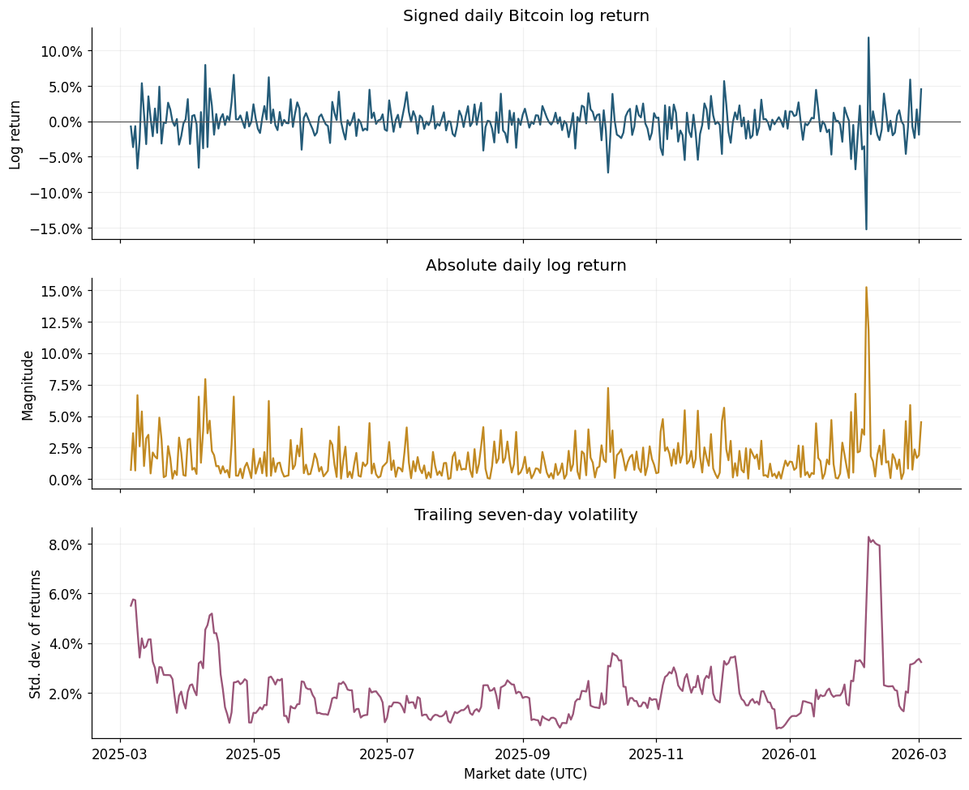
Volatility target and forecast design
Target: next-day absolute log return, |ln(P t+1 / P t)|
Clock: forecast after UTC close of day t; lagged features only
Split: 200 dates; 159 training origins, 41-day holdout, 4 expanding folds
Raw link: mean sentiment vs next-day volatility, correlation −0.069

Slide 11
Forecast results: the simple mean wins on MAE
MAE: mean benchmark 0.01169 beats every model
RMSE and direction: forests reach 0.0185 vs 0.0201 and 65.9% vs 53.7% high-volatility accuracy
Spikes: all models miss the large volatility days
Forest and Ridge rows use market and activity features.

Slide 12
Does sentiment help explain volatility?
Improves forecasts?
Positive or negative?
Association or causation?
Barely. RoBERTa cuts MAE by 0.78% (Ridge) and 1.70% (forest); VADER worsens Ridge by 0.52%. It wins in 1 of 4 folds and its interval includes zero.
Negative: coefficient −0.000230. More positive sentiment goes with smaller predicted moves, not with price direction.
Association only. News can drive both tweets and volatility, and markets can drive sentiment.
Bottom line: better sentiment labels do not guarantee better volatility forecasts.

Slide 13
Conclusion
Themes: Six stable NMF topics. Trading signals dominate at 47.5% and grew slightly, while NFT talk drifted down.
1
Sentiment: Twitter RoBERTa (73.3%) outperformed VADER (63.3%) on 60 human-labelled tweets.
2
Volatility: Sentiment adds a small, uncertain gain. The mean benchmark has the lowest MAE, and the evidence is association, not causation.
3

Slide 14
Suggestions and recommendations
Recommendations
Future work
Monitor themes: track NMF topic shares as a conversation dashboard
Filter first: remove templated and promotional posts before analysis
Choose RoBERTa: prefer it to VADER for tweet sentiment
Stay cautious: do not build trading rules on tweet sentiment alone
Better data: verify timestamps, add non-English tweets and a longer history
Bigger review: label hundreds of tweets, with more Negative cases
Richer models: GARCH-X, ARIMAX, intraday data and topic-level sentiment
Rolling backtests: report intervals across many windows

